Slide 1
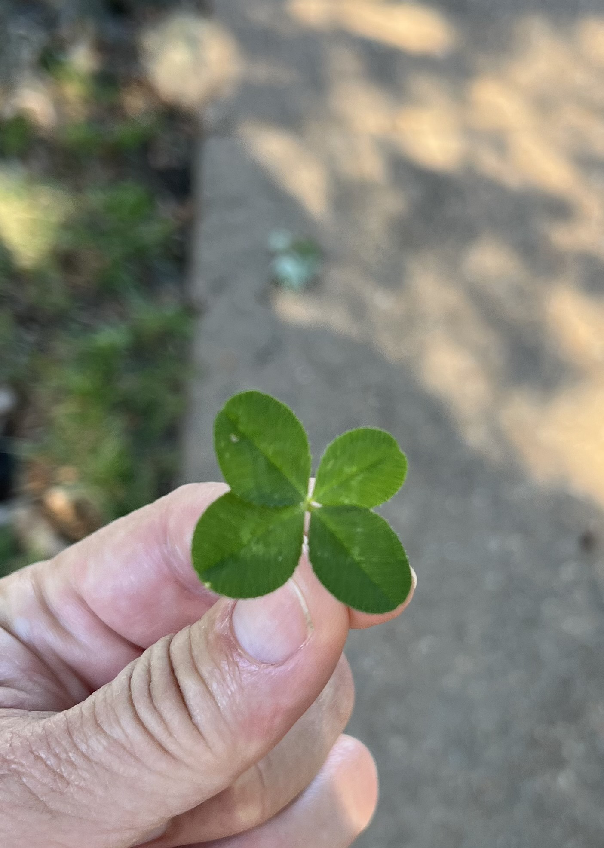
Genetic Fortune Decoded: Using LLMs to Discover Four-Leaf Clover Secrets
A Journey into the Genetics of Luck with AI

Slide 2
Introduction
Brief overview of the significance of four-leaf clovers.
Mention the role of genetics in determining the four-leaf trait.
Introduce the use of AI and LLMs in genetic research.

Slide 3
Four-Leaf Clover and Genetics

Slide 4
The Role of AI and LLMs

Slide 5
Identifying Candidate Genes
- **Gene 1**: Description, location
- **Gene 2**: Description, location
- **Gene 3**: Description, location

Slide 6
Python Code Snippets
# Sample code to fetch gene sequences
from Bio import Entrez, SeqIO
def fetch_sequence(gene_id):
Entrez.email = 'your.email@example.com'
handle = Entrez.efetch(db='nucleotide', id=gene_id, rettype='fasta', retmode='text')
return SeqIO.read(handle, 'fasta')

Slide 7
Data Analysis with AI

Slide 8
Results and Findings

Slide 9
Conclusion
Summarize findings with infographics.
Visual representation of the genetic analysis process.

Slide 10
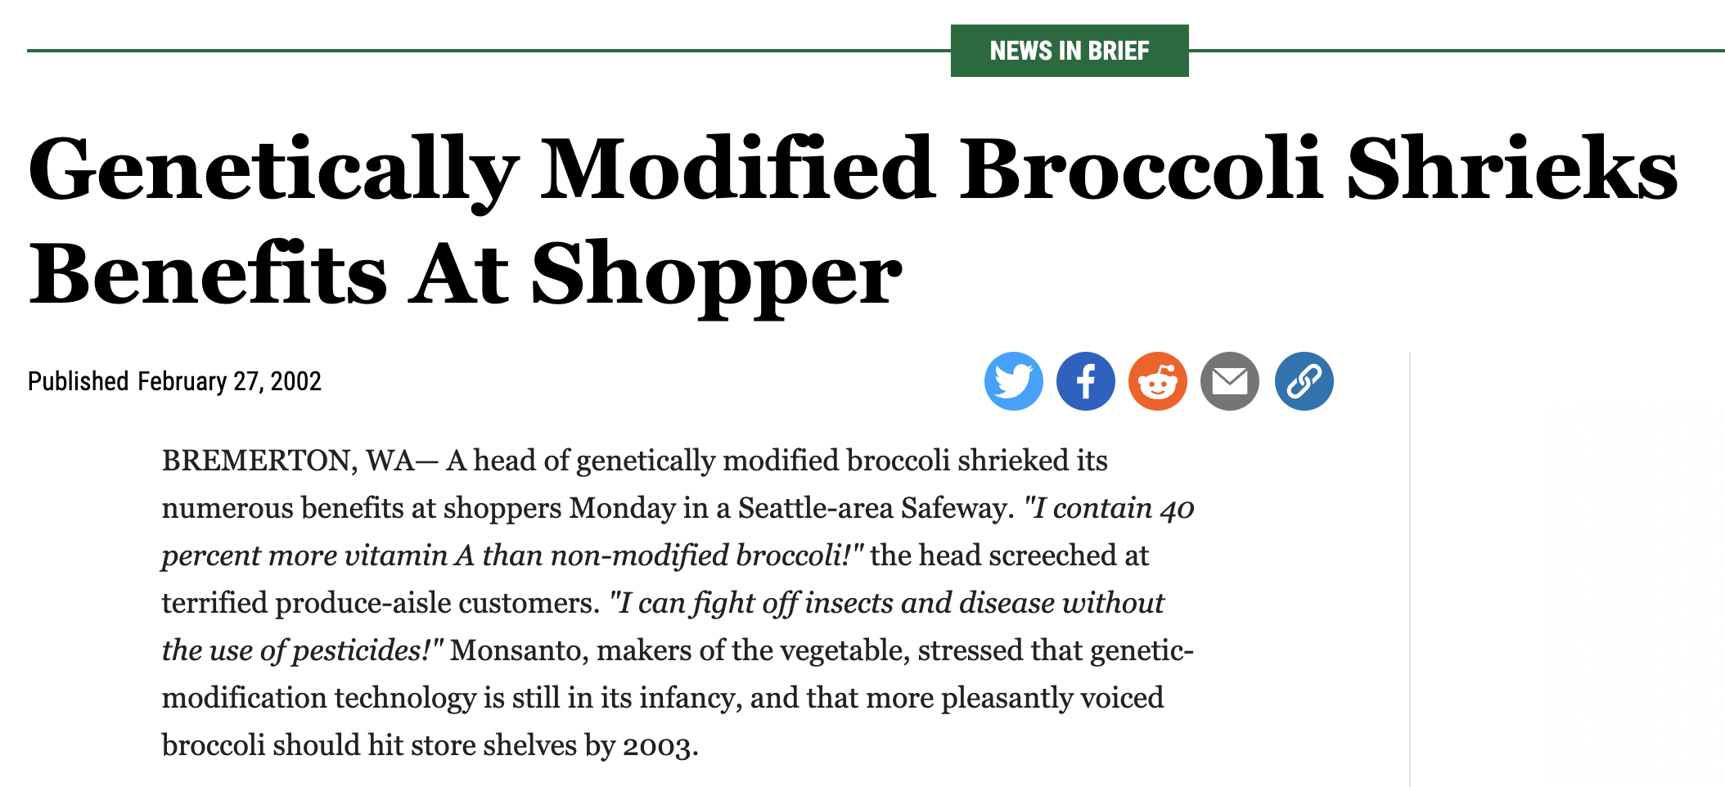
And now, to the Onion

Slide 11
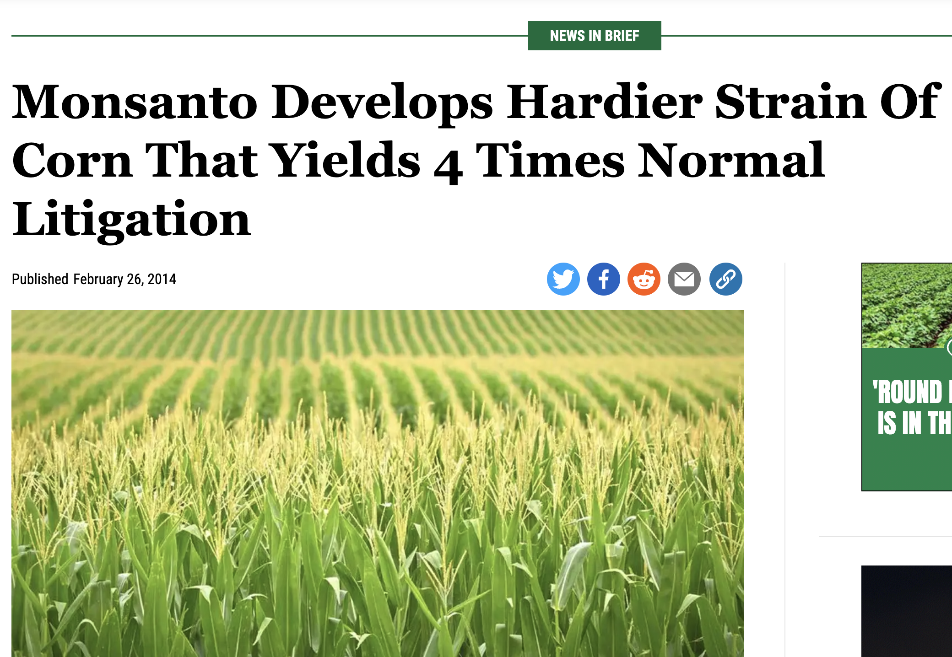
And now, to the Onion

Slide 12
Questions and Discussion
Open floor for questions.
Engage with the audience.

Slide 13
